Slide 1
The Giver
By: Lois Lowry
Presented by: ryan mollett

Slide 2
Summary of The Giver
Jonas receives memories from the past (good/bad). He is being trained by the Giver a wise old man that has received memories from the community for a very long time. During the course of training, Jonas starts finding out some of the deepest darkest secrets about his society. Jonas keeps on receiving memories that take him through exhilarating experiences. After all of his training and his experience he attempts to escape his community and to escape from all of the lies and secrets.

Slide 3
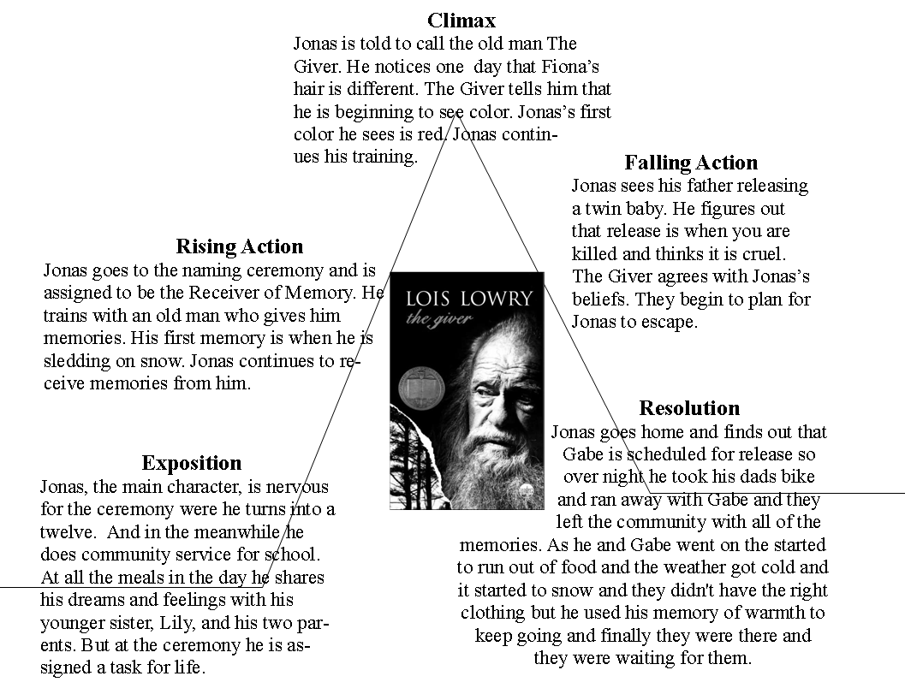
Plot diagram

Slide 4
Setting and tone.
Setting: The novel does not specifically state the time it takes place but it does state way into the future on planet Earth
Tone: The tone of The Giver is straight to the point philosophical but not overly preachy, and often ironic.

Slide 5
Main character traits, influences, and point of view
Jonas a 12 year-old boy and the main character of The Giver, is polite compassionate. In the beginning of the story Jonas is unconcerned about how he is living he grew up with loud speakers roleas and a family that is not biological, he accepted this way of life because he doesn’t know any other way of existence

Slide 6
Main conflict
The main conflict is when Jonas is chosen to be the receiver of memory. The text states: In a firm commanding voice she announced, “ Jonas has been selected to be our next receiver of memory.”

Slide 7
Theme #1
being emotionless gets you nowhere in life-
Text evidence: stated in chapter 22 If he had stayed, he would have lived a life hungry feelings, for color, for love.

Slide 8
Theme 2
Never give up
Text evidence as stated in chapter 23: But he had come this far he must try to go on

Slide 9
Theme 3
Its okay to ask questions
Text evidence as stated in chapter 1: “ How did you feel when you were there”?

Slide 10
Compared to All summer in a day
Both novels take place in the future. Jonas lives on Earth while Margot the main character of all summer in a day lives on Venus. They both are in the same kind of age range and have seen things no one else has seen.

Slide 11
Most impactful sign post
Tough question on page 58: What had he done wrong?
It made me wonder what he did do wrong or why he thinks he has done something wrong

Slide 12
Conclusion
I think the most memorable aspect of the novel is how Jonas and Gabriel choose not to follow the community and follow their despicable ways that they uncover throughout the novel. I think the novel is important because it has so many good themes and you can relate to how the characters feel and how they are treated. I would recommend this book to someone because it has a very good plot and mystery type vibe to it.

